Slide 1
SQL Programming
SQL Processing Model – Part 3

Slide 2
Module 11: SQL Processing Model Page A-1: Intro
In a previous module we examined a model that describes how SQL processes the programs we write.
In this module we’ll extend our understanding and describe how SQL ‘does’ a join.

Slide 3
Module 11: SQL Processing Model Page B-1: SQL Processing Model
As you study this processing model keep in mind that it is only a model. A model to help you better understand how SQL works, and hence a model to help you when writing your SQL programs.
And although no single SQL implementation works in exactly this fashion, as a programmer, you can rely on them all to behave in this fashion.

Slide 4
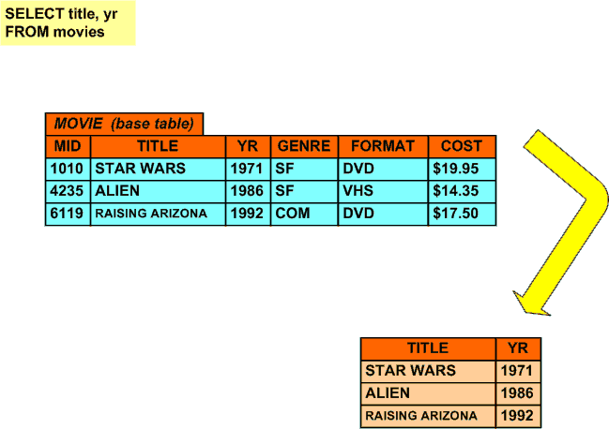
Module 11: SQL Processing Model Page B-2: SQL Processing Model
Our inquiry started with the question: Can SQL process and execute program statements in a top-to-bottom fashion.
That is, can it execute the SELECT clause, and then read and execute the FROM clause, and then read and execute the WHERE clause, ….
Upon some reflection we came to realize that NO, SQL cannot sequentially process and execute statements.
SQL has no context for the columns that are listed in the SELECT clause without knowing which table(s) to use for those columns.
Any reference to a column must be preceded by knowledge about the table that that column resides in.

Slide 5
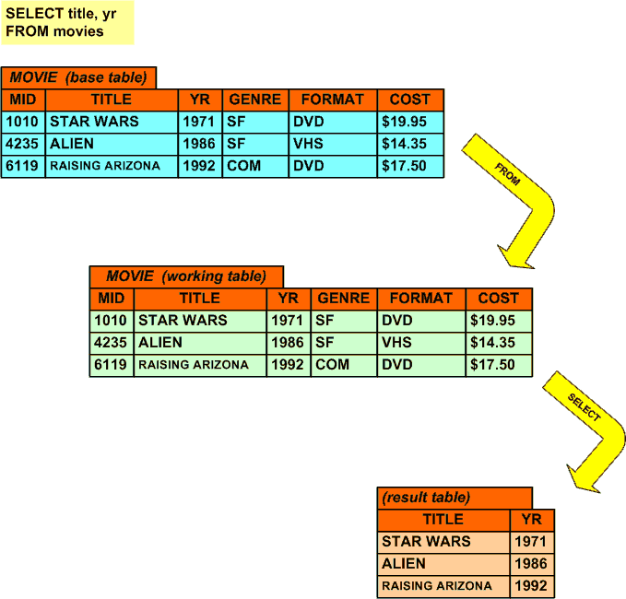
Module 11: SQL Processing Model Page B-3: SQL Processing Model
This understanding helped us develop our 1st intuition: The FROM clause is processed first.
And in this regard you can think of the FROM clause as building a working copy of the base table.
This working copy will be the foundation for all subsequent working tables, up through the creation of the final result table.

Slide 6
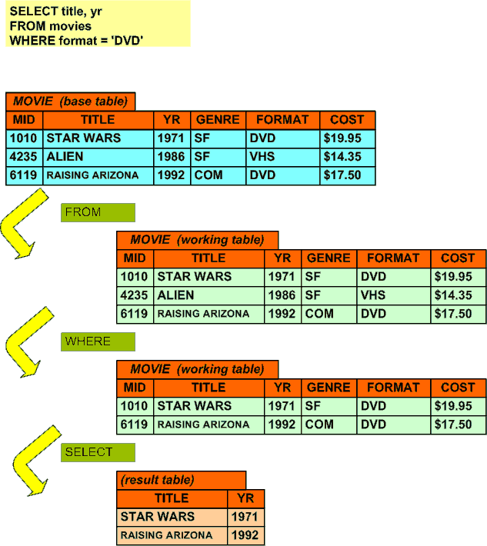
Module 11: SQL Processing Model Page B-4: SQL Processing Model
Then we considered a query such as the following one:
SELECT title, yr
FROM movie
WHERE format = ‘DVD’
And from here we developed our 2nd intuition that suggests that: WHERE clause processing follows the FROM clause.
The FROM clause builds a working copy of the base table(s) that are referenced in the FROM clause.
The WHERE clause then creates another intermediate working table, and this table includes only the rows that satisfy the WHERE condition.
Then the SELECT clause builds the result table by including only the columns that are named in the SELECT clause

Slide 7
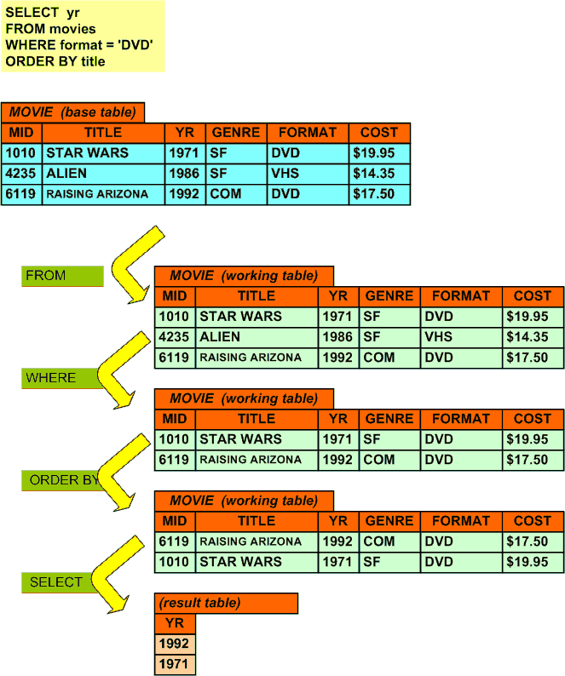
Module 11: SQL Processing Model Page B-5: SQL Processing Model
And finally, after considering the ORDER BY clause, we came to generalize that the SELECT clause is the last clause to be processed.
This SQL processing model suggests that SQL generates a number of intermediate working tables (or intermediary tables) on it’s way to preparing the final result table.
In this sequencing of ‘steps’, the FROM clause is processed first, hence we say that the FROM clause lays the foundation for all subsequent processing
---------------
The WHERE clause is the next statement that is processed.
The WHERE clause tells SQL which rows in the table it should keep, and pass along to the next step.

Slide 8
Module 11: SQL Processing Model Page C-1: SQL Processing Model
When we examined some of the more advanced ‘set’ feature of the language, eg. DISTINCT and GROUP BY, we saw that our processing model could be adapted to accommodate those features of the language as well.

Slide 9
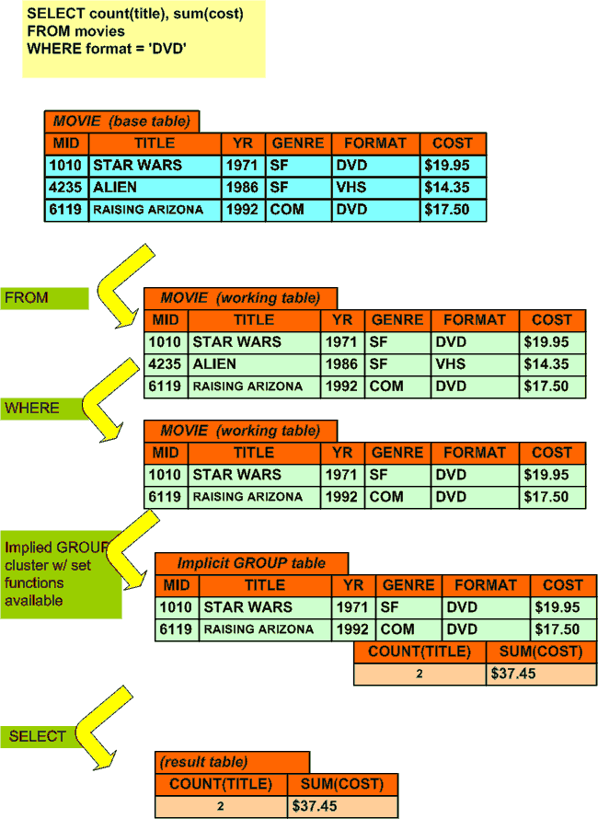
Module 11: SQL Processing Model Page C-2: SQL Processing Model
My intuitions about set functions suggest that even without a GROUP BY clause, there must be some implicit grouping or clustering of the data, so that the set function have a ‘body of data’ to work with.
And along with this implicitly grouped body of data, all of the column functions become available.
In the diagram I try to portray the availability of the set functions with the pseudo-result table that is part of the implicit group table.
After the set functions are calculated (ie. after they become available) the remaining clauses of the program kick in (ORDER BY and then SELECT)

Slide 10
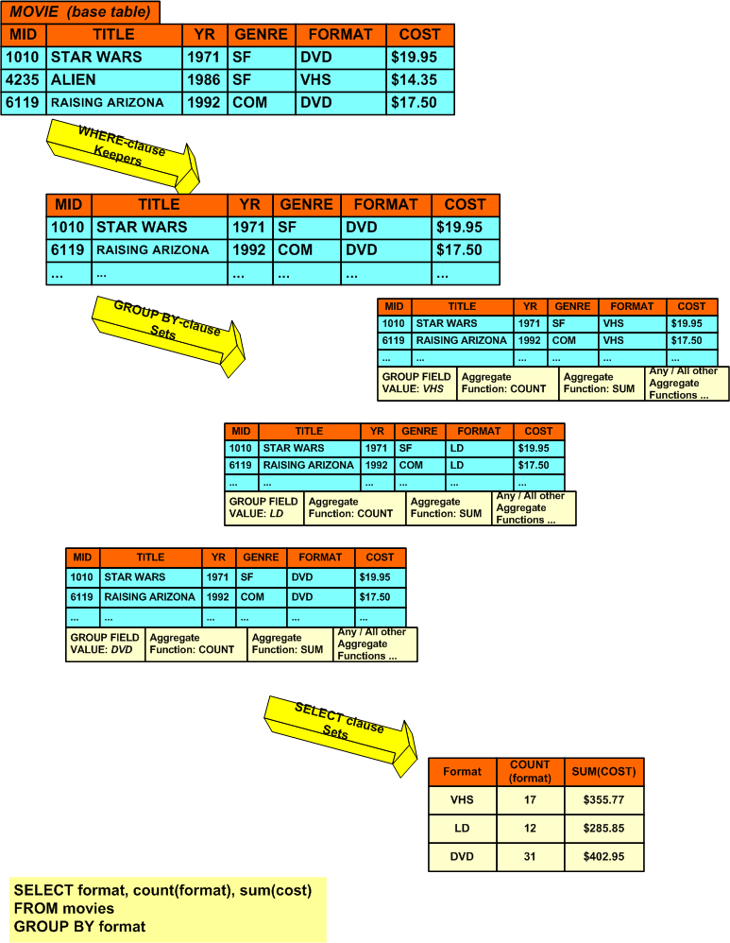
Module 11: SQL Processing Model Page C-3: SQL Processing Model
This slide demonstrates how the GROUP BY clause generates working tables for each data value combination of the grouped columns.
In my mind, these tables are explicitly generated by the GROUP BY clause. (Remember though that this is a conceptual model of SQL processing – this ain’t necessarily how it works, but it is how it behaves [sort of ☺])
In this particular example, three group cluster tables are generated, one for each of the data values that occurs in the format column of the movies table (DVD, LD, VHS).
And note: the final result table draws its rows, taking one row’s worth of information from each of the working group tables.
Sorry the diagram is a little cluttered, as you no doubt surmise, I’m artistically challenged.

Slide 11
Module 11: SQL Processing Model Page C-4: SQL Processing Model
We applied the model to set functions and grouping. Now let’s extend it to cover the HAVING clause.
This is the same diagram as on the last slide, I ran out of room ☹ but we can work it out.
---
As noted, the final result table draws its rows, taking one row’s worth of information, from each of the working group tables.
It’s at this stage, as the final result table is being put together that the HAVING clause applies. Only those result rows in the group tables that meet the criteria will be included in the final result table.
Then, any ordering clauses apply, and finally the SELECT clause applies.

Slide 12
Module 11: SQL Processing Model Page D-1: SQL Processing Model
The question before us now is, can we adapt this model to accommodate multi-table joins, or is it time to abandon it in favor of something else?

Slide 13
Module 11: SQL Processing Model Page D-2: SQL Processing Model
In my opinion, this model is flexible enough to accommodate the adaptation.
So, let’s see how it works.

Slide 14
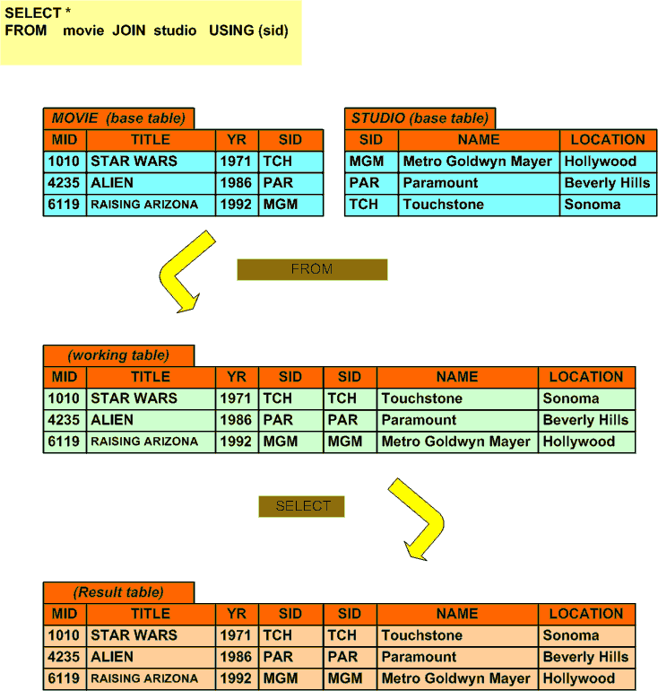
Module 11: SQL Processing Model Page D-3: SQL Processing Model
We accept that the FROM clause kicks in first, and builds the first working table.
Our rationale for placing the FROM clause first was due in part to the fact that SQL has no reference for the columns named in either the SELECT nor the WHERE clauses, without knowing which tables to use. The FROM clause was the only link to this information.
Now we see another reason for having the FROM clause go first. It builds the appropriate join tables as called for by the programmer.
In the older technique, the programmer used the FROM clause to create a cross product of the tables, and then, in conjunction with the WHERE clause, identified the rows to be carried forward.

Slide 15
Module 11: SQL Processing Model Page D-4: SQL Processing Model
In the newer technique, the programmer specifies the type of join in the FROM clause.
But the important thing to note is that it’s still the FROM clause that is creating the join.
Once we have the tables joined, we can carry on from there as before.

Slide 16
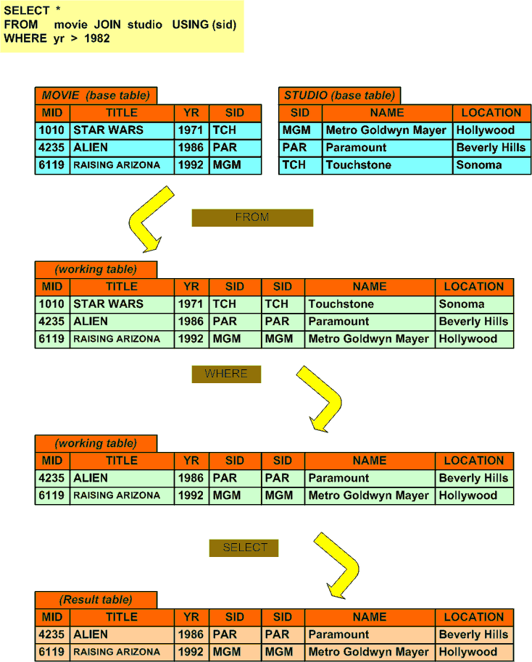
Module 11: SQL Processing Model Page D-5: SQL Processing Model
If there is a WHERE clause it is processed after the tables have been joined.
Just as before.

Slide 17
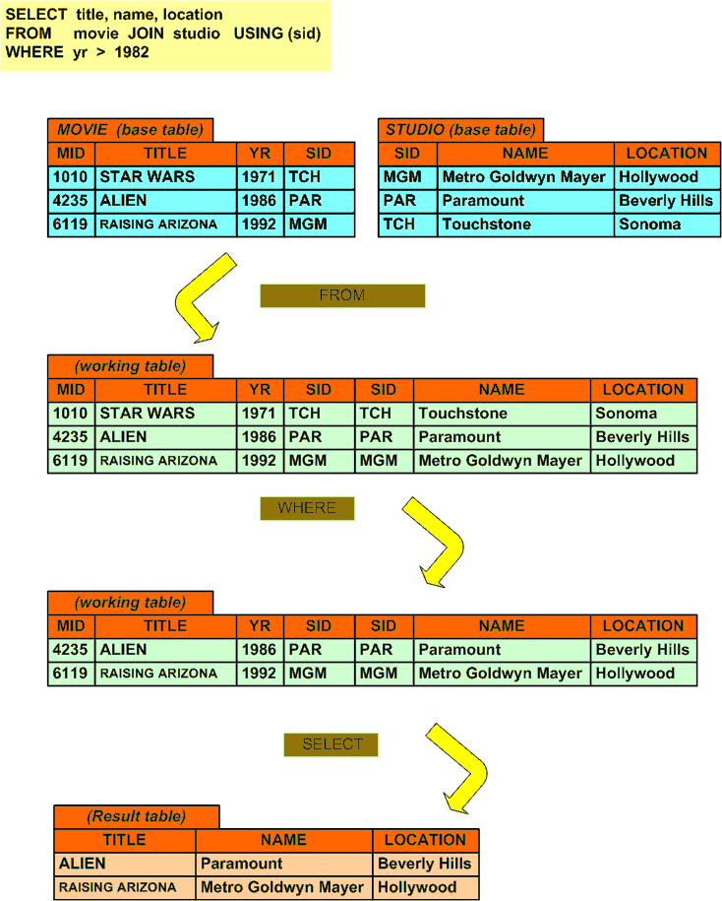
Module 11: SQL Processing Model Page D-6: SQL Processing Model
The SELECT clause is the last clause to be applied.
Just as before.

Slide 18
Module 11: SQL Processing Model Page E-1: Summary
The FROM clause is applied first.
The WHERE clause is applied next, if it occurs.
The GROUP BY clause follows, along with the HAVING clause.
ORDERING occurs next.
And finally the SELECT clause.

Slide 19
Module 11: SQL Processing Model Page Z-1: End Notes
Please drop me an email if you noticed any errors in this module. I’d also appreciate reading your comments, criticisms, and or suggestions as to how this module could be improved.
Were there any gaps in the information that was presented (ie. ‘leaps of faith’)?
Was any section unclear?
Did I happen to do a good job? ☺
Thanks,
bil

Slide 20
That’s All

